Slide 1
MKU
School of Medicine
MBMP 1323 : Cardiovascular Physiology II
Topic: Blood flow & Hemodynamics
By J. Alfred, BSc, MSc, MA, PhD cont.
Email: alfredjuma2015@yahoo.com

Slide 2
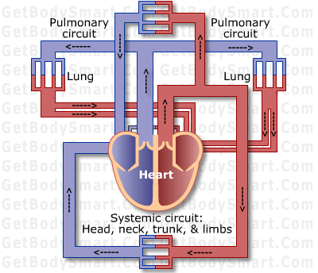
CIRCULATORY ROUTES
Blood vessels are organized in circulatory routes that carry blood throughout the body
Two main circulatory routes
Systemic
Pulmonary

Slide 3
Systemic Circulation
Arteries and arterioles carry blood containing oxygen and nutrients from left ventricle to systemic capillaries throughout body
Veins and venules carry blood containing carbon dioxide and waste to the right atrium
Blood that leaves the aorta and travels through systemic arteries is bright red
Blood moves through the capillaries, loses oxygen and takes on carbon dioxide becoming dark red in color

Slide 4
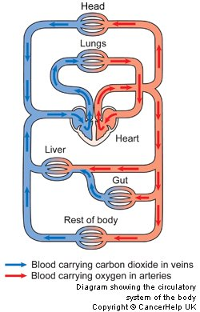
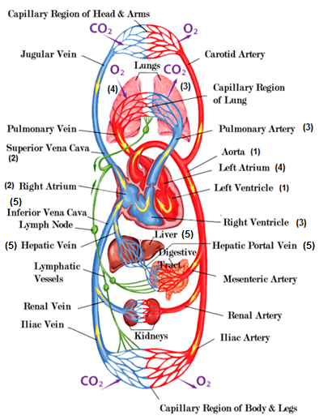
Notes:
Systemic Circulation:
All systemic arteries branch off of aorta, which arises from left ventricle of the heart carrying oxygenated blood to all parts of the body.
Deoxygenated blood returns to the heart through systemic veins; superior vena cava to inferior vena cava (coronary sinus) to right atrium.
Pulmonary Circulation:
When deoxygenated blood returns to the heart from the systemic route, it is pumped out the right ventricle through the pulmonary artery into the right lung where it loses CO₂.
Blood moves into the left lung, picks up O₂, and then returns to left atrium of heart, to once again go through systemic circulation.
Hepatic Portal Circulation:
Hepatic portal vein carries blood from one capillary network to another, namely from the GI to the liver. In the liver substances from the GI tract are processed before pushed out the hepatic vein into the inferior vena cava for circulation throughout the body.

Slide 5
Pulmonary Circulation
When deoxygenated blood returns to the heart from the systemic route, it is pumped out the right ventricle through the pulmonary artery into the right lung where it loses CO₂.
Blood moves into the lung, picks up O₂, and then returns to left atrium of heart, to once again go through systemic circulation.
We will place more focus on this when we discuss the heart…

Slide 7
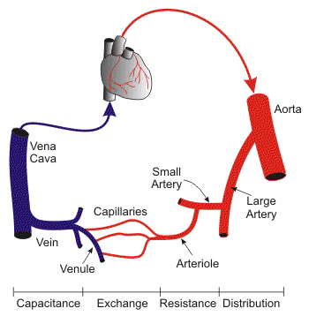
Venous Return
Volume of blood flowing back to heart through veins, occurs through pressure generated in three ways:
Contractions of the heart
Skeletal muscle pump
Respiratory pump

Slide 8
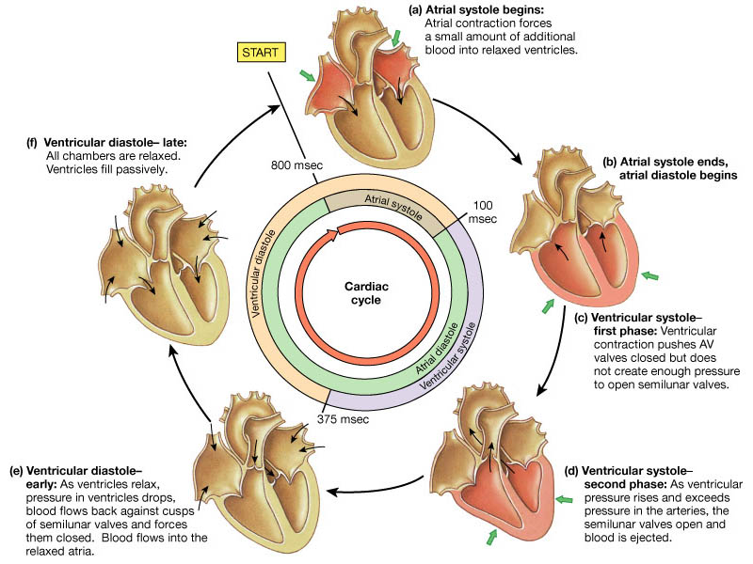
Heart Contractions-cardiac cycle
Notes:
Contractions of the heart
BP (systolic and diastolic) generated by contraction of heart’s ventricles and measured in millimeters of mercury (Hg)

Slide 9
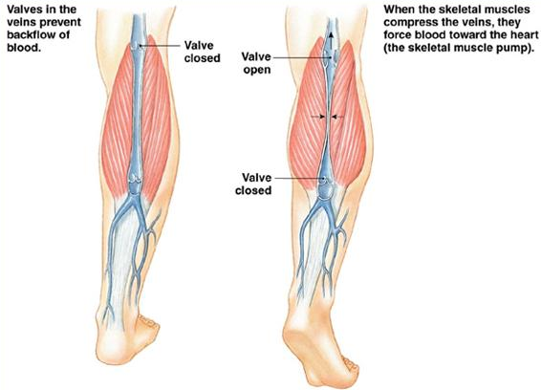
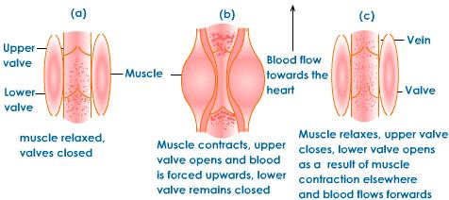
Skeletal Muscle Pump
Notes:
Skeletal muscle pump_
Locomotory activity promotes venous return, i.e. walking, running. Veins in legs and arms have one-way valves that direct flow away from limb to the heart. Muscles compress (contraction phase) the veins propels blood forward through distal (upper) valves. Muscles decompress (relaxation phase) proximal valves open, blood flows into and fills venous segment. Both of these work together to create enough pressure to propel blood to heart.

Slide 10
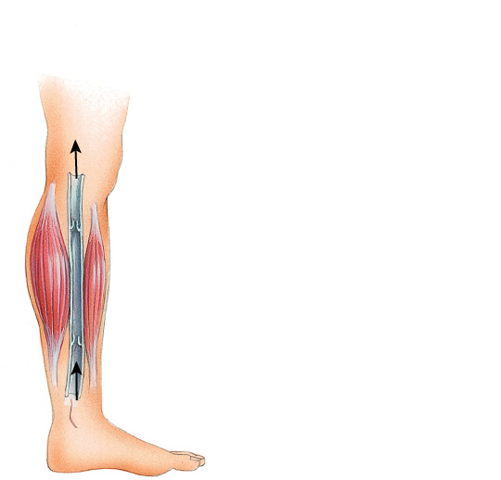
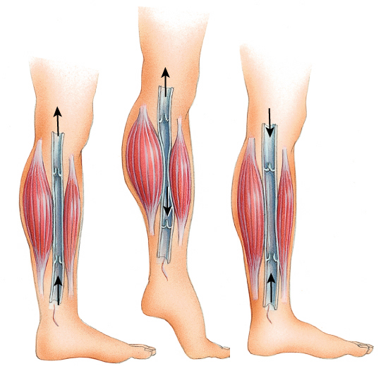
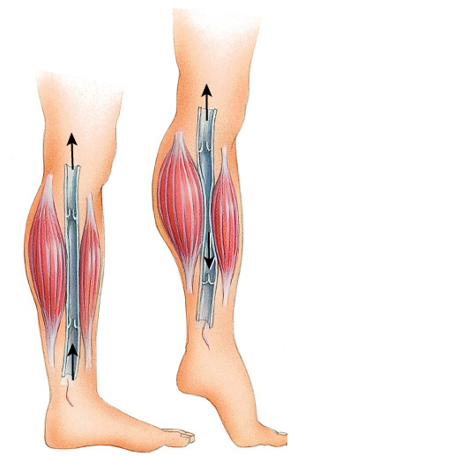
Proximal
valve
Proximal
valve
Proximal
valve
Distal
valve
Distal
valve
Distal
valve
1
1
1
2
2
3

Slide 11
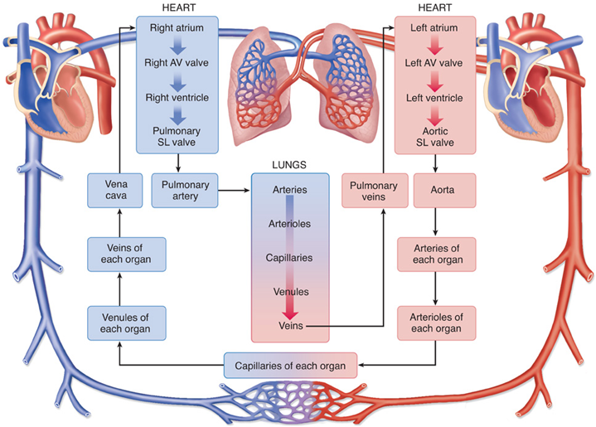
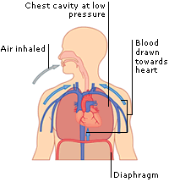
Respiratory Pump
Notes:
_Respiratory pump_
Also based on alternating compression and decompression of veins. You inhale, diaphragm moves downward = decrease in pressure in thoracic cavity, abdominal veins are compressed, thus blood moves from compressed abdominal veins to decompressed thoracic veins and then into right atrium of heart. You exhale; valves in veins prevent backflow of blood from thoracic to abdominal veins.

Slide 12
BLOOD FLOW THROUGH BLOOD VESSELS
From areas of higher pressure to areas of lower pressure
greater the pressure difference the greater the blood flow
Contractions of the ventricles generate blood pressure (BP)
Blood pressure is the measure of pressure exerted by blood on the walls of a blood vessel
highest in the aorta and large systemic arteries

Slide 13
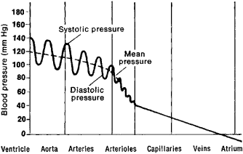
Systolic versus Diastolic
Systolic (contraction) measures maximum arterial pressure occurring during contraction of the left ventricle of the heart
Average = 120mm Hg
High end begins = 140mmHg
Diastolic (relaxation) measures arterial pressure during the interval between heartbeats
Average = 80mm Hg
High end begins = 90mmHg

Slide 14
Resistance
Vascular resistance → opposition to blood flow due to friction between blood and the walls of blood vessels
Increase in vascular resistance = increase in BP
Decrease in vascular resistance = decease in BP
Vascular resistance is dependent upon:
Size of the blood vessel (lumen)
Smaller means greater resistance to blood flow; alternates between vasoconstriction and vasodilation
Blood viscosity
Ratio of RBCs to plasma volume
Higher viscosity = higher resistance
Total blood vessel length
Resistance increase with total length
Longer the length = greater contact between vessel wall and blood

Slide 15
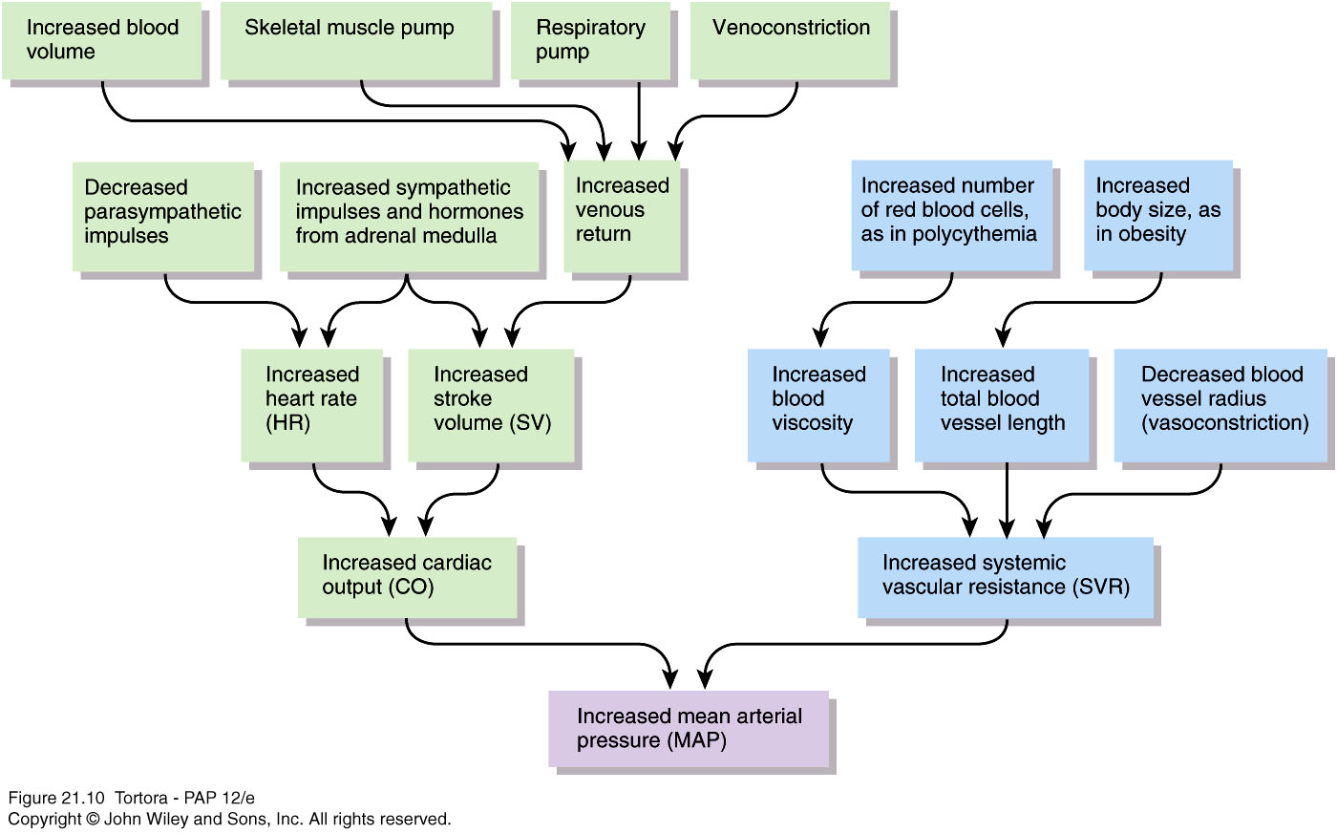

Slide 16
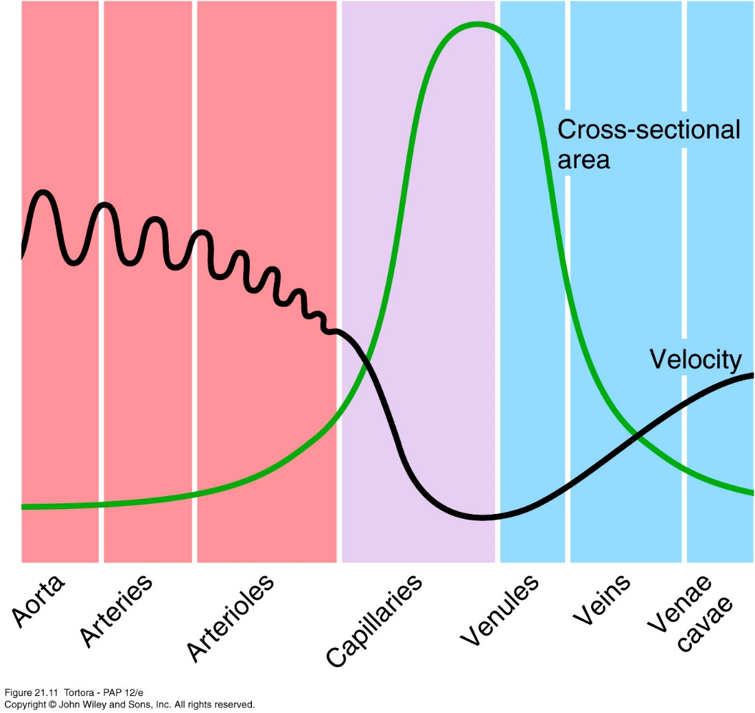
Relationship between Velocity of Blood Flow and Total Cross-sectioned area in Different Types of Blood Vessels

Slide 17
Control of blood pressure and blood flow
Interconnected negative feedback systems control blood pressure by adjusting heart rate, stroke volume, systemic vascular resistance, and blood volume
Some act faster that others
Some shorter- or longer-term

Slide 18
1. Role of cardiovascular center (CV)
In medulla oblongata
Helps regulate heart rate and stroke volume
Also controls neural, hormonal, and local negative feedback systems that regulate blood pressure and blood flow to specific tissues
Groups of neurons regulate heart rate, contractility of ventricles, and blood vessel diameter
Cardiostimulatory and cardioinhibitory centers
Vasomotor center control blood vessel diameter
Receives input from both higher brain regions and sensory receptors

Slide 19
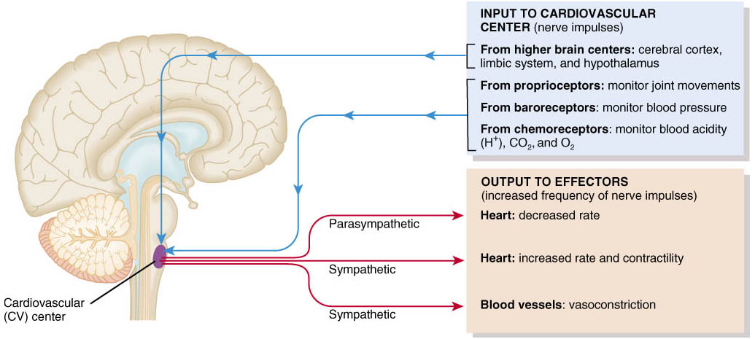
Role of the Cardiovascular Center
Cardiovascular Center (CV) in the medulla oblongata regulates heart rate and stroke volume
Notes:
Done thru interconnected negative feedback systems that control BP and blood flow by adjusting heart rate, stroke volume, vascular resistance, and blood volume
CV also controls neural and hormonal negative feedback systems that regulate BP and blood flow to specific tissues
INPUT: from higher brain regions; cerebral cortex, limbic system, and hypothalamus…do things like increase heart rate in coordination with nerve impulses (excited), vasodilation of blood vessels allows heat to dissipate to surface of skin
Input from sensory receptors; proprioceptors → monitor movement of joints/muscles = increase in heart rate during physical activities; baroreceptors → in aorta, internal carotid arteries (neck to brain) and other large arteries of neck/chest sends impulses to regulate BP; chemoreceptors → monitor blood levels of oxygen, carbon dioxide, and hydrogen ions trigger vasoconstriction to increase pressure
OUTPUT: READ CHART IN PIC…

Slide 20
3 main types of sensory receptors
Proprioceptors – monitor movements of joints and muscles to provide input during physical activity
Baroreceptors – monitor pressure changes and stretch in blood vessel walls
Chemoreceptors – monitor concentration of various chemicals in the blood
Output from CV flows along neurons of ANS
Sympathetic (stimulatory) opposes parasympathetic (inhibitory)

Slide 21
Neural regulation of blood pressure
Negative feedback loops from 2 types of reflexes
Baroreceptor reflexes
Pressure-sensitive receptors in internal carotid arteries and other large arteries in neck and chest
Carotid sinus reflex helps regulate blood pressure in brain
Aortic reflex regulates systemic blood pressure
When blood pressure falls, baroreceptors stretched less, slower rate of impulses to CV
CV decreases parasympathetic stimulation and increases sympathetic stimulation

Slide 22
Neural regulation of blood pressure
Chemoreceptor reflexes
Receptors located close to baroreceptors of carotid sinus (carotid bodies) and aortic arch (aortic bodies)
Detect hypoxia (low O₂), hypercapnia (high CO₂), acidosis (high H⁺) and send signals to CV
CV increases sympathetic stimulation to arterioles and veins, producing vasoconstriction and an increase in blood pressure
Receptors also provide input to respiratory center to adjust breathing rate

Slide 23
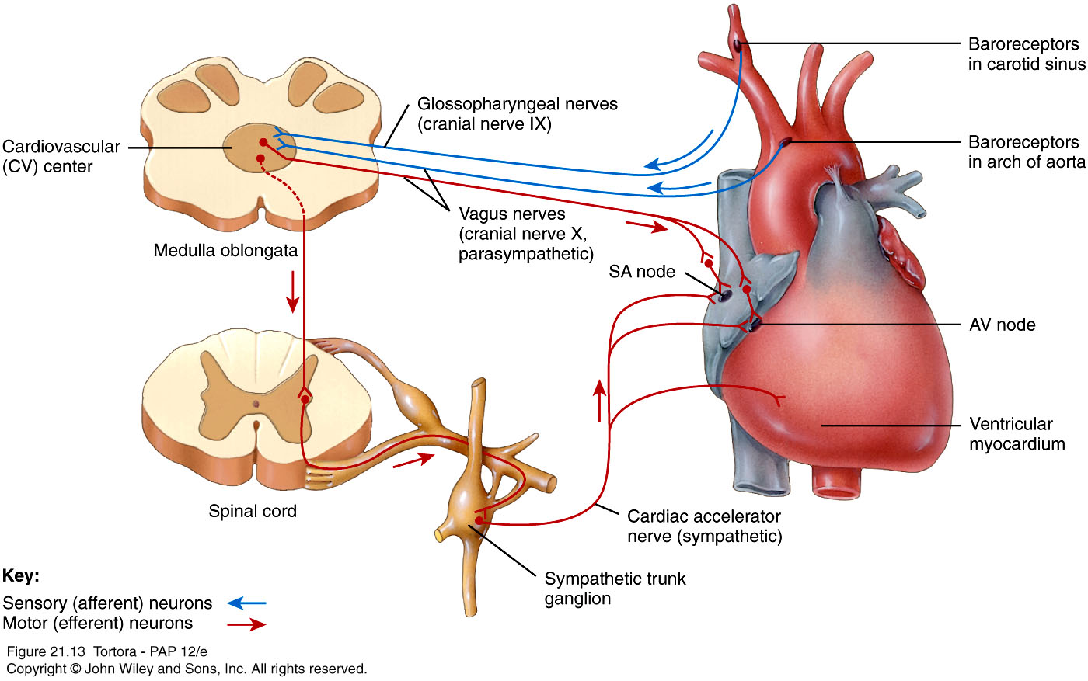

Slide 24
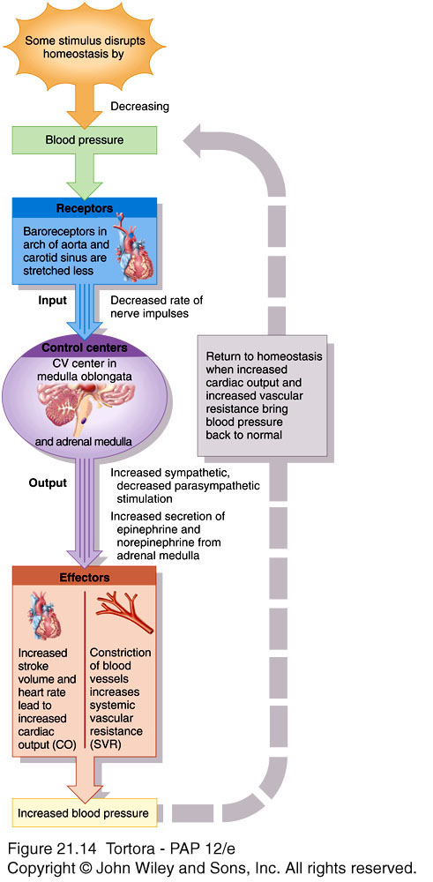

Slide 25
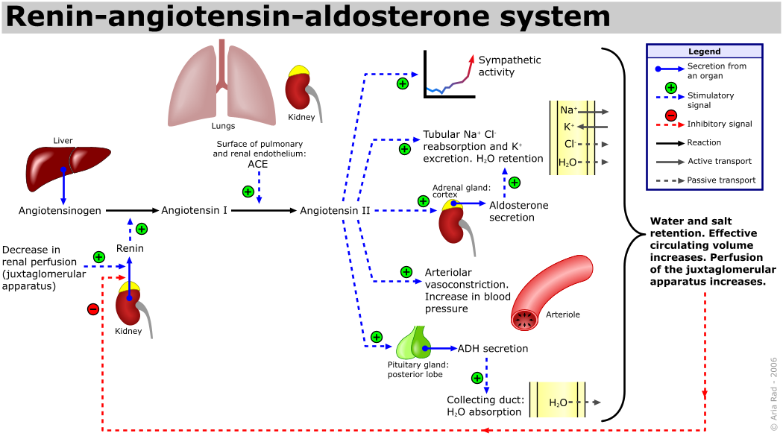
Hormonal Regulation of Blood Pressure and Blood Flow
2. (RAA system):
Notes:
if blood volume falls or blood flow to kidneys decreases, RAA system works to raise BP through vasoconstriction and increase reabsorption of sodium and water to increase blood volume

Slide 26
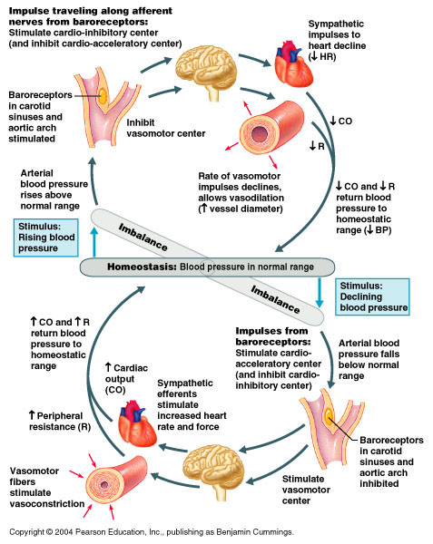
3. Epinephrine and norepinephrine
Notes:
respond to sympathetic stimulation, adrenal medulla releases these to increase cardiac output by increasing the rate and force of heart contractions; causes vasoconstriction

Slide 27
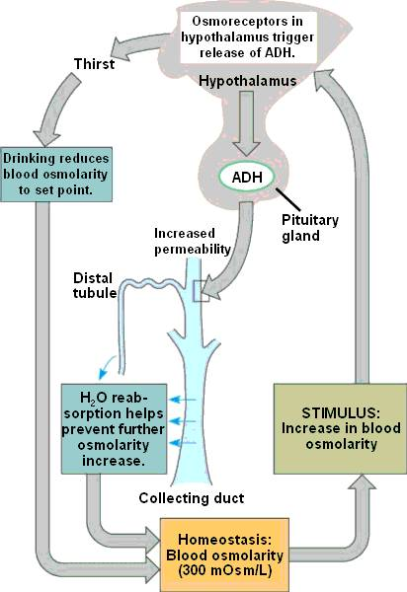
4. Antidiuretic hormone (ADH)
Notes:
produced by hypothalamus, released by posterior pituitary in response to dehydration or decreased blood volume; causes vasoconstriction to increase BP; thus ADH is known as vasopressin----YOU NEED A DRINK

Slide 28
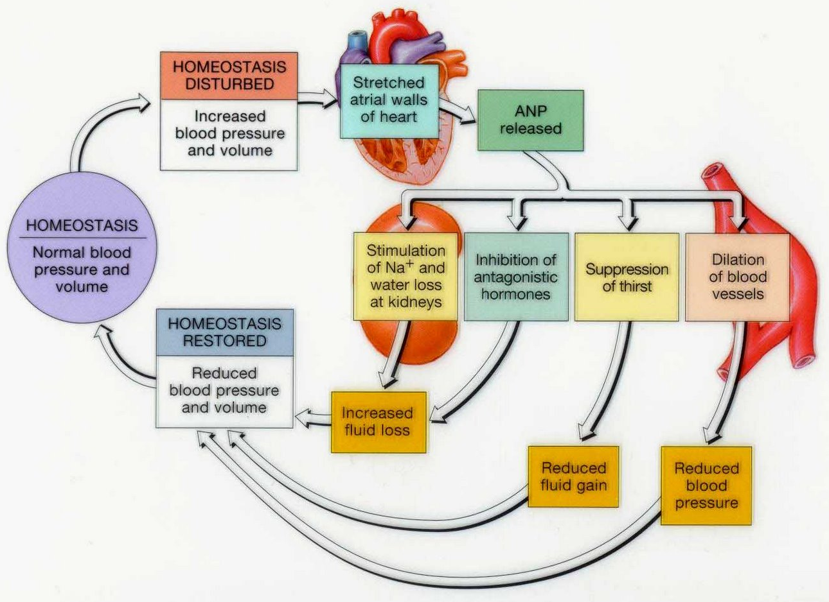
5. Atrial natriuretic peptide (ANP)
Notes:
released by cells in atria of heart; lowers BP, cause vasodilation, promotes loss of salt and water in urine, thus reducing blood volume

Slide 29
5. Autoregulation of blood pressure
Ability of tissue to automatically adjust its blood flow to match metabolic demands
Demand of O₂ and nutrients can rise tenfold during exercise in heart and skeletal muscles
Also controls regional blood flow in the brain during different mental and physical activities
2 general types of stimuli
Physical – temperature changes, myogenic response
Vasodilating and vasoconstricting chemicals alter blood vessel diameter

